Slide 1
机场英语口语任务
4 Tasks
1、Traffic Pattern五边飞行
2、航站楼构型
3、跑道安全区域

Slide 2
口语 Task 1
对飞机五边飞行的描述

Slide 3

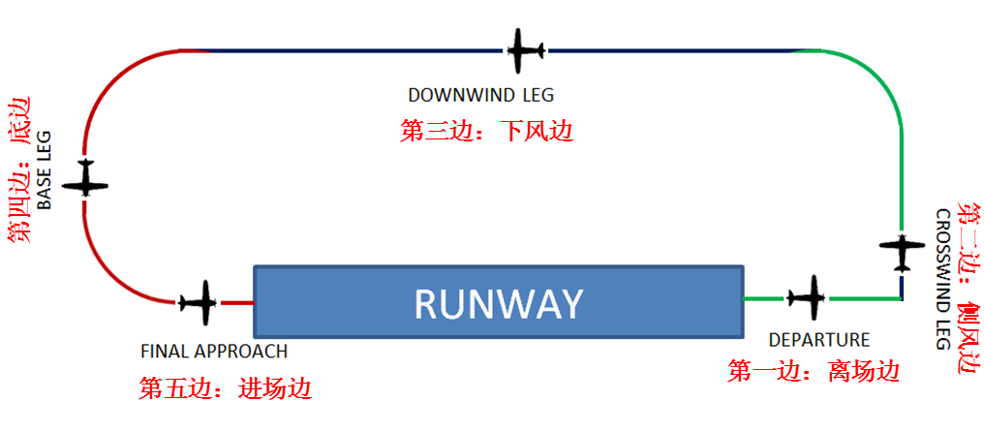
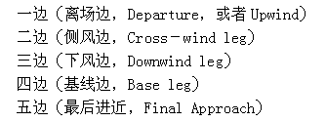
6. airport traffic pattern
traffic pattern 起落航线、交通模式，（也叫做“五边飞行”）

Slide 4
6. Airport traffic pattern
Patterns are typically rectangular in basic shape, and include the runway along one long side of the rectangle. Each leg of the pattern has a particular name
Upwind leg or Departure: A flight path parallel to and in the direction of the landing runway.
Crosswind leg. A short climbing flight path at right angles to the departure end of the runway.
Downwind leg. A long level flight path parallel to but in the opposite direction of the landing runway.
Base leg. A short descending flight path at right angles to the approach end extended centerline of the landing runway.
Final approach. A descending flight path in the direction of landing along the extended runway centerline from the base leg to the runway. The last section of the final approach is sometimes referred to as short final.

Slide 5
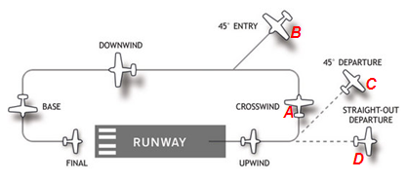
描述下面四架飞机的飞行轨迹

Slide 6
描述下面四架飞机的飞行轨迹
3
4
2
5
1

Slide 7
phrases for direction and angle
be parallel to
in the direction of
in the opposite direction of
along the centerline
be at the right angel to
with a 45° turn in the direction of
with a 45° turn agianst direction of
join the pattern at a 45° angle

Slide 8
飞机沿五边飞行的描述句子
（以一飞完五边的飞机A为例）
The plane flies along the upwind leg which is parallel to and in the direction of the landing runway, until it reaches the end of upwind leg.
Then, it flies into the crosswind leg, which is at right angles to the departure end of the runway.
On the downwind leg, it flies along a path which is parallel to but in the opposite direction of the landing runway until it reaches the end of the downwind leg.
Then, the plane flies into the base leg at right angles to the approach end extended centerline of the landing runway.
Finally, the plane reaches the final approach leg, a descending flight path in the direction of landing along the extended runway centerline from the base leg to the runway.

Slide 9
飞行中含有45度夹角的说法
(以右图中的飞机BCD为例)
Plane D：
The plane first flies along the upwind leg, which is parallel to and in the direction of the landing runway, until it reaches the end of upwind leg. After that, it makes a straight-out departure.
Plane C:
The plane flies along the crosswind leg,which is at right angles to the departure end of the runway. And then it flies awaywith a 45° turn in the direction of the crosswind leg.
Plane B:
The plane joins the pattern/the downwind leg at a 45° angle, and then flies along the downwind leg.

Slide 10
口语 Task 2
对航站楼的五种构型进行描述：包括 introduction、merits and demerits

Slide 11

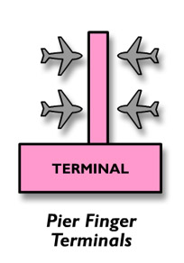



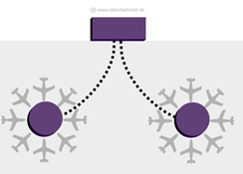
1.3 Design of Terminal

Slide 12
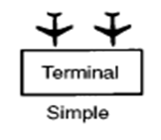
1.3 Design of Terminal
Simple Configuration介绍
In the simple-style configuration of an airport, aircraft are parked on the apron angled either nose-in or nose-out, for self-taxi in and out.
Passengers walk across the tarmac to the terminal building or to the aircraft.
This design is still common among smaller airports.
Simple Configuration 简单式构型
nose-in 机头向内
Nose-out 机头向外

Slide 13
Simple Configuration的缺点
Though perhaps appropriate for small low-density airports, having passengers walking around the tarmac creates security and safety concerns,
and is less convenient for passengers and their baggage.
Simple Configuration 简单式构型

Slide 14

1.3 Design of Terminal
Linear Terminal Concept介绍
As airports expanded to meet the growing needs of the public, as well as the growing wingspans of aircraft, simple-unit terminals expanded outward in a rectangular or linear manner.
Linear Terminal 线型航站楼

Slide 15
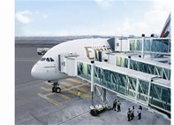
1.3 Design of Terminal
Linear Terminal Concept的优点
The advantages of the linear terminal configuration include:
the simple access from the Terminal buildings to the airplanes,
a simple installation of the passenger loading bridges
sufficient space for technical handling equipment and staff at the level of the terminal
passenger loading bridges

Slide 16
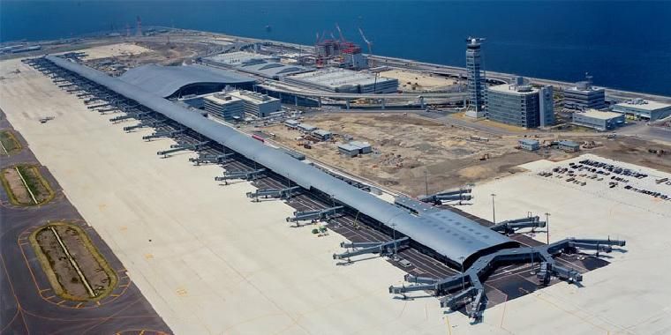
1.3 Design of Terminal
Linear Terminal Concept的缺点
One of the main disadvantages of linear terminals becomes evident as the length of the terminal building increases. Walking distances between facilities, particularly distantly separated gates, become excessive for the passenger whose itinerary requires a change in aircraft at the airport.

Slide 17

1.3 Design of Terminal
Curvilinear Terminal Concept介绍和优点
In some instances airports were extended in a curvilinear fashion, allowing even more aircraft to park "nose-in" to the terminal building while maintaining short walking distances from the airport entrance to the aircraft gate.
curvilinear adj. 曲线的；由曲线组成的

Slide 18
1.3 Design of Terminal
Pier Finger Terminal 介绍
Aircraft are parked side-by-side along both sides of a terminal pier which juts into the apron area. In many large airports, the introduction of piers was practically the only possibility for providing a greater number of contact stands and to increase the capacity of the airport.
Pier Finger Terminal 指廊式航空站
http://www.zhihu.com/question/24473580

Slide 19
1.3 Design of Terminal
Pier Finger Terminal 的优点和缺点
A pier design uses a small, narrow building with aircraft parked on both sides. One end connects to a ticketing and baggage claim area. Piers offer high aircraft capacity and simplicity of design, but often result in a long distance from the check-in counter to the gate.
Pier Finger Terminal 指廊式航空站

Slide 20
1.3 Design of Terminal
Satellite Terminal Concept介绍
In this concept, aircraft are parked all the way around a satellite terminal from the main terminal, and connected with the main terminal building by underground tunnels or by overhead corridors.
Satellite Terminal 卫星厅式航站楼

Slide 21
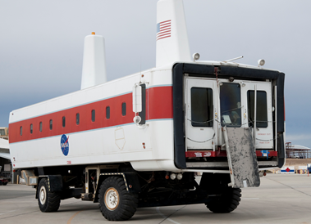
1.3 Design of Terminal
Satellite Terminal Concept 优缺点
The main advantage of the remote satellite concept is that one or more satellite facilities may be constructed and expanded when necessary while providing sufficient space for aircraft taxi operations between the main terminal building and satellites.
As with the pier finger concept, the expansion of pier satellite and remote satellite concept terminals tend to result in terminal facilities that not only have large distances between key points within the terminal, but also often become confusing for passengers in their attempts to find their way to their respective gates, baggage claim areas, or other desired facilities. Therefore, it is necessary to transport passengers between the terminal building and satellites, usually with a high frequency automated people mover.
Dulles Airport People Mover
people mover 行人运输工具

Slide 22
口语 Task 3
跑道周围安全区域的描述
name, function and location of each area,

Slide 23
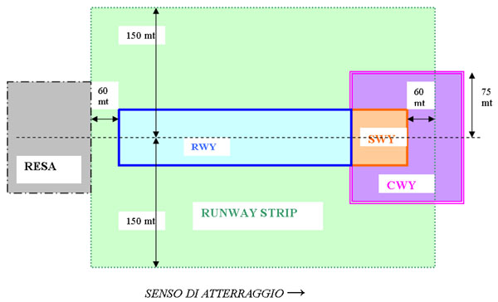

Slide 24

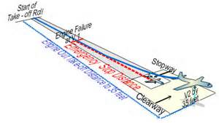
5. Clearway
A defined rectangular area on the ground or water under the control of the appropriate authority, selected or prepared as a suitable area over which an airplane may make a portion of its initial climb to a specified height.
function of CWY
Clearway 净空道
Notes:
先讲Stopway,在回头看clearway
净空道，为跑道端之外的地面和向上延伸的空域，对地面没有要求，可以是路面，也可以是水面，

Slide 25

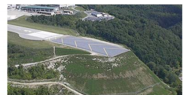
6. Stopway
Stopway, also known as blast pad or overrun area, is a defined rectangular area on the ground at the end of the runway prepared as a suitable area in which an aircraft can be stopped in the case of an abandoned take-off.
1st function of STOPWAY
Stopway 停止道
Blast pad喷气防护坪

Slide 26
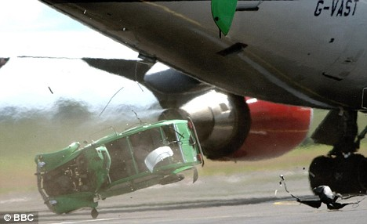
6. Stopway
2rd function of STOPWAY
Stopways, are also constructed just before the start of a runway where jet blast produced by large planes during the takeoff roll could otherwise erode the ground and eventually damage the runway.
jet blast
jet blast 喷气

Slide 27

7. Runway Strip
A runway strip is an area enclosing(包围、围住) a runway and any associated stopway. Its purpose is to:
(a) reduce the risk of damage to an airplane running off the runway
(b) protect airplanes flying over it during take-off or landing operations
Functions of runway strip
Runway Strip升降带

Slide 28

8. Runway End Safety Areas
Runway end safety area (RESA):
an area symmetrical about the extended runway center line and adjacent to the end of the strip primarily intended to reduce the risk of damage to an aeroplane undershooting or overrunning the runway.
Functions of RESA
Runway End Safety Areas 跑道端安全地区

Slide 29
8. Runway End Safety Areas
Difficulties for RESA
One of the difficulties is that overshooting aircraft don't always leave the runway straight off the end at relatively slow speed;
they leave from the side of the runway (like the Congonhas A320 incident),
they leave off the end at such a high speed that they would overrun any safety area (like the AF358 A340 incident in Toronto),
or they land well short of the runway (like BA38 B777 incident at Heathrow).
overshoot vt. 超越；超出

Slide 30
口语 Task 4
Recognize each Ground Service equipment

Slide 31
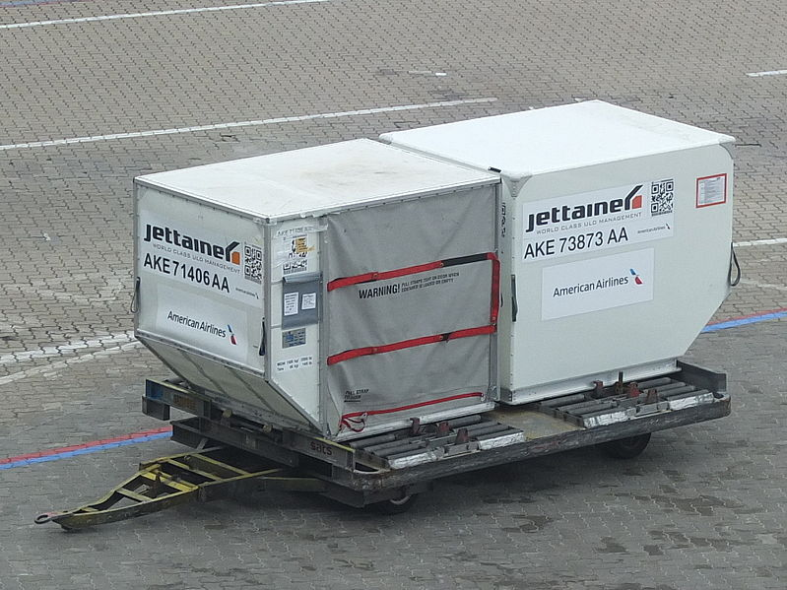
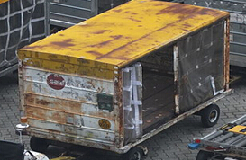
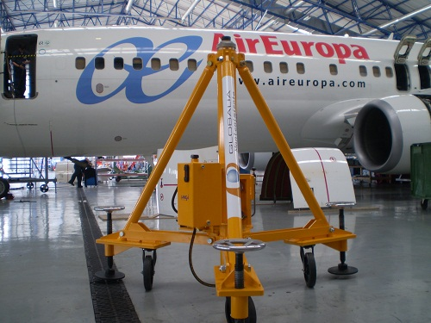
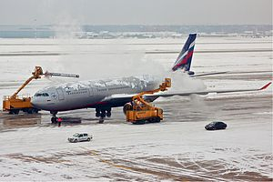

Slide 32
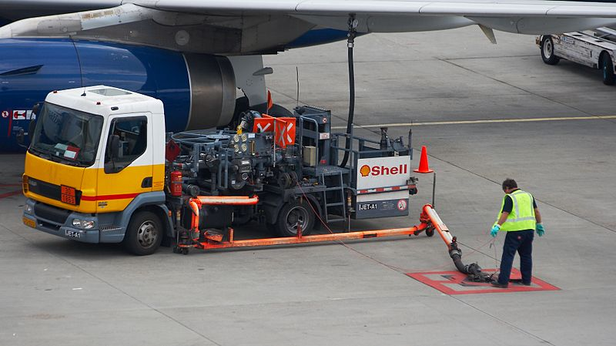
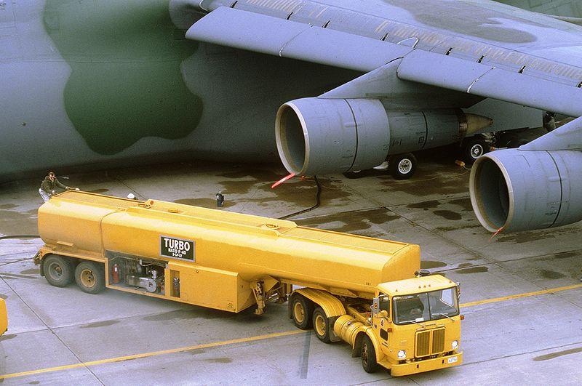
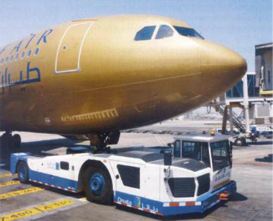
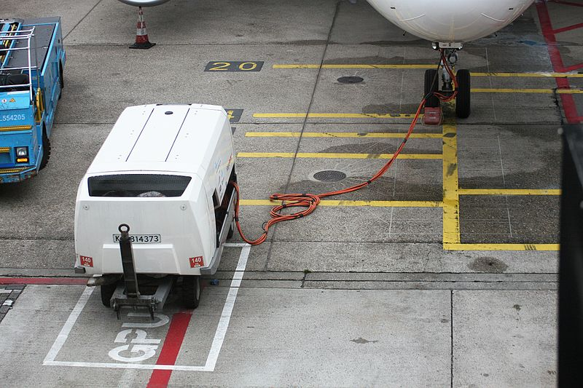
Ground power unit that needs towing

Slide 33
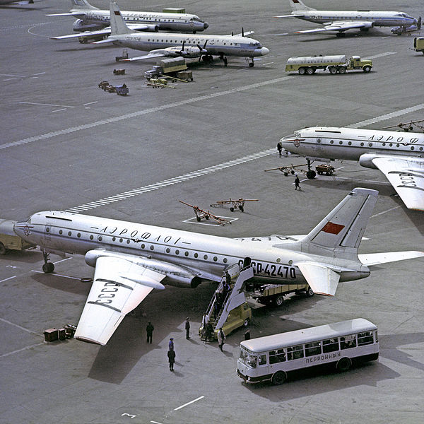
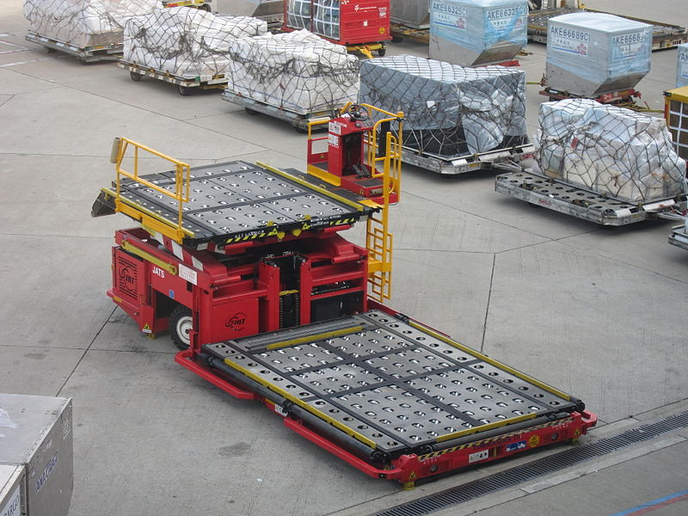
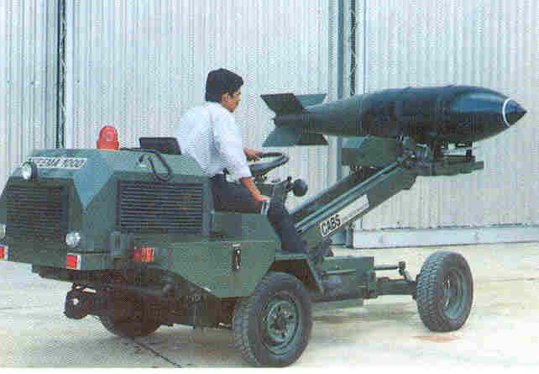
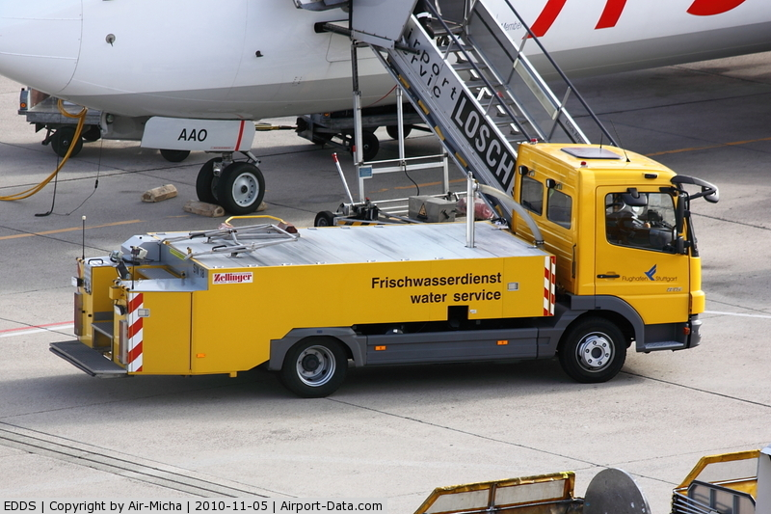

Slide 34
